Slide 1
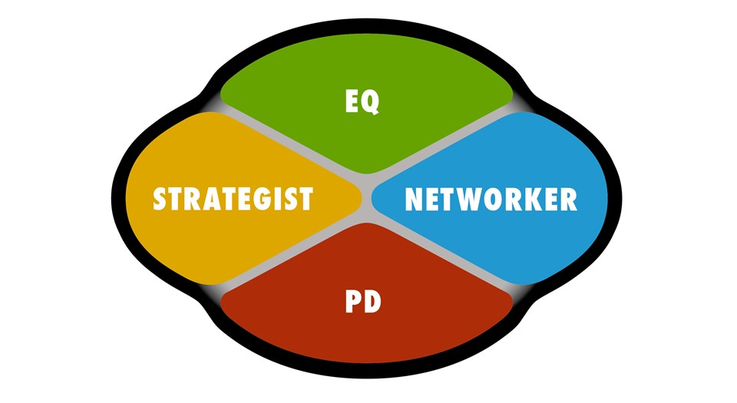
Team Primary Intellect Map
EQs:
Jim Smith
Strategists:
Fred Jones
Networkers:
Joe Bloggs
PDs:
Mary Christmas

